Slide 1
Logistic Regression

Slide 2
Contents
Introduction to Logistic Regression
Logistic Function
Hypothesis Representation
Assumptions
Types of Logistic Regression

Slide 3
Logistic Regression
Logistic regression is one of the most popular Machine learning algorithm that comes under Supervised Learning techniques.
Logistic Regression is used when the dependent variable(target) is categorical.
e.g.: To predict whether an email is spam (1) or (0)
Whether the tumour is malignant (1) or not (0)

Slide 4
Logistic Regression
It can be used for Classification as well as for Regression problems, but mainly used for Classification problems.
The output of Logistic Regression problem can be only between the 0 and 1.
Logistic regression can be used where the probabilities between two classes is required. Such as whether it will rain today or not, either 0 or 1, true or false etc.
Logistic regression is based on the concept of Maximum Likelihood estimation. According to this estimation, the observed data should be most probable.

Slide 5
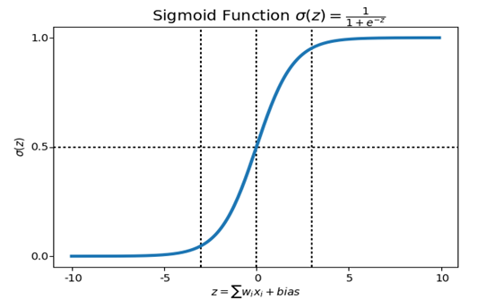
Logistic Function
In logistic regression, we pass the weighted sum of inputs through an activation function that can map values in between 0 and 1. Such activation function is known as sigmoid function and the curve obtained is called as sigmoid curve or S-curve.

Slide 6
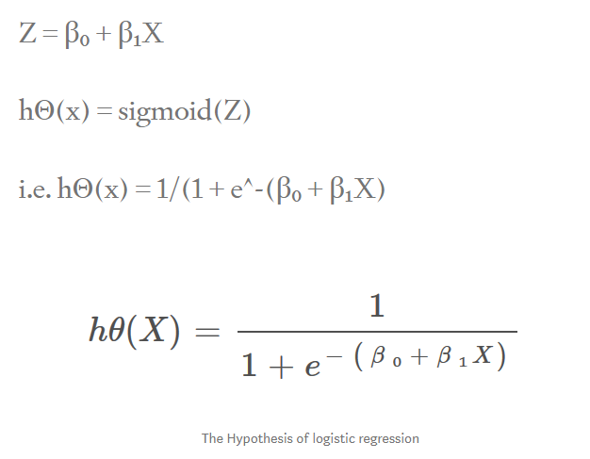
Hypothesis Representation
For logistic Regression, we use the formula of hypothesis i.e.,

Slide 7
Assumptions
In case of binary logistic regression, the target variables must be binary always and the desired outcome is represented by the factor level 1.
There should not be any multi- collinearity in the model, which means the independent variables must be independent of each other.
We must include meaningful variables in our model.
We should choose a large sample size for logistic regression.

Slide 8
Types of Logistic Regression
Binary or Binomial: A dependent variable will have only two possible types either 1 and 0. E.g., these variables may represent success or failure, yes or no, win or loss etc.
Multinomial : Dependent variable can have 3 or more possible unordered types or the types having no quantitative significance. E.g., these variables may represent “Type A” or “Type B” or “Type C”.
Ordinal : Dependent variable can have 3 or more possible ordered types or the types having a quantitative significance. E.g., “poor” or “good”, “very good”, “Excellent” and each category can have the scores like 0,1,2,3

Slide 9
Thank You

